Slide 1

Bank Marketing (Campaign)
Data Science Virtual Internship
Name: Sainad Reddy Naini (Individual)
Email: nainisainad@gmail.com
Country: India
College: University of Bath (Graduate -UK)
Specialization: Data Science

Slide 2

Agenda
Problem Description
Approach
EDA
EDA Summary
Recommended Models

Slide 3
problem Description
ABC Bank is preparing to launch a new term deposit product and aims to maximize the effectiveness of its marketing efforts. To achieve this, they want to develop a machine learning (ML) model that can predict whether a customer will subscribe to the term deposit based on historical data from previous marketing campaigns. This predictive model will help the bank identify potential customers who are more likely to purchase the product, allowing them to focus their marketing efforts more effectively and efficiently.

Slide 4
Approach
Data Preparation
Check for null values, missing data, data types, and duplicates to ensure clean data.
Feature Engineering
Enhance the dataset by adding relevant columns (features) to facilitate visualizations and trend analysis.
Exploratory Data Analysis
Explore the data to understand patterns, relationships, and key insights.
Insights and recommendations
Summarize key findings and provide actionable insights.
Model building
While this presentation focuses on recommendations, we suggest specific models for technical users to explore.

Slide 5
EDA (Understanding the Data)
Before diving into the analysis, let's first understand the dataset. It is a publicly available dataset from the UCI Machine Learning Repository, containing information from a marketing campaign by a Portuguese banking institution. The dataset includes details about customer features and whether they subscribed to a term deposit.
There are two files in the dataset, but I have used the bank-full-additional.csv file, which contains 21 columns and 41,188 rows. This file provides more data, which helps improve the accuracy of the predictions compared to the other file.
The dataset contains both numeric and categorical columns, so we will proceed with exploratory data analysis (EDA) accordingly.

Slide 6
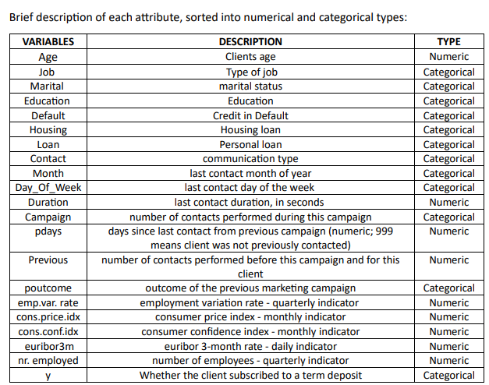
EDA (Understanding the Data)
While understanding the data, I focused on two main questions:
What are the problems in the dataset ?
How can we solve these problems?
Fig:- The dataset consists of 21 columns, including the target variable (y), along with some basic descriptions.

Slide 7
EDA (Understanding the Data- What are the problems in the dataset ?)
What are the problems in the dataset ?
The dataset has no missing values, but it does contain some unknown values in the columns for job, marital, education, default, housing, and loan. There are also outliers present in the columns for age, duration, pdays, previous, and campaign. Additionally, the dataset is imbalanced, meaning some categories have far more data than others. Finally, there is some skewness in the data, which means that certain variables are not evenly distributed.

Slide 8
EDA (Understanding the Data- How can we solve these problems?)
How can we solve these problems?
Although there are no missing values, the dataset has some unknown values. We can handle these by replacing them with the most common value in that column, like using the most frequent answers for housing, loan, and education. If the unknown data is very small, it might be easier to just remove those entries, such as for job and marital.
To deal with outliers, which are extreme values that can affect our results, we can remove them, adjust their values, or apply techniques to reduce their impact.
For the problem of class imbalance, where some categories have less values compared to others, we can use methods to balance the data, such as undersampling(reducing examples for the overrepresented ones). Another option is to ensure that both training and testing datasets are balanced. We should also keep an eye on how well our model performs and adjust our methods as needed to improve accuracy.

Slide 9
EDA (Types of Analysis)
Before moving forward, I have already dealt with the issues in the data, like unknown values, outliers, and duplicate entries, as explained in the previous slide. These are basic steps in data cleaning and preparation. Now, we are ready to move on to more detailed analysis.
Since we have both numerical and categorical (non-numeric) values, we will explore univariate and bivariate analysis, which involves analyzing single and paired variables for both types of data.

Slide 10
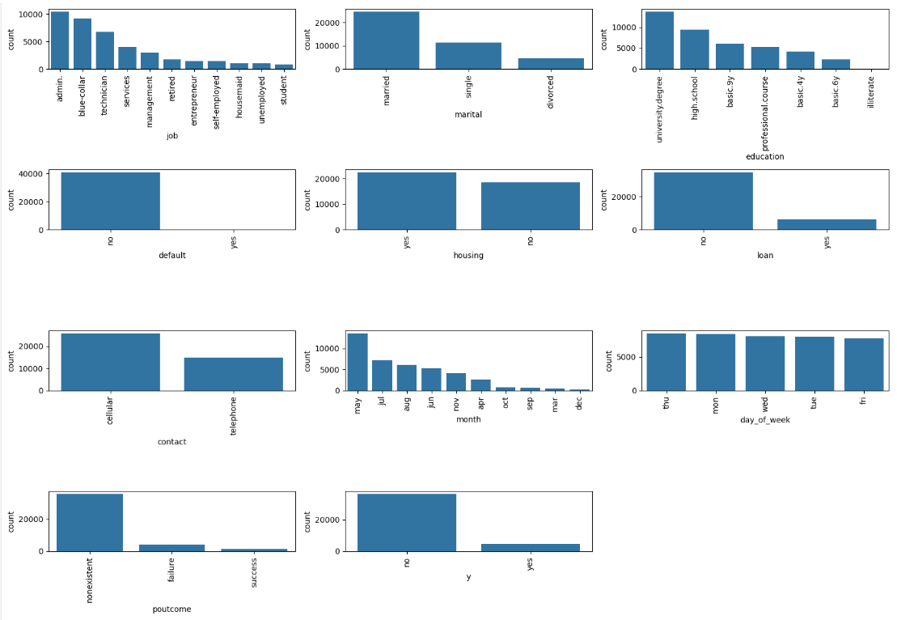
EDA (Univariate Analysis of Categorical Features)
There are 10 categorical features(columns) in this dataset excluding y(target variable).

Slide 11
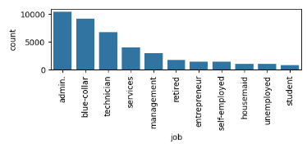
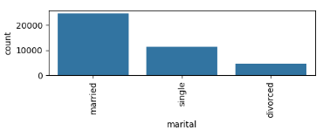
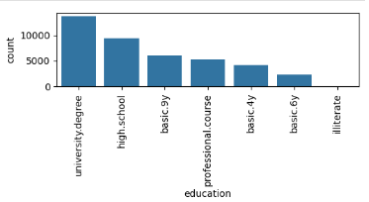
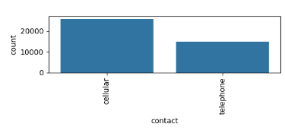
EDA (Univariate Analysis of Categorical Features)
Most people in the dataset have administrative jobs, followed by blue-collar workers and technicians. There are fewer students.
More people in the dataset are married.
Most of the clients in the dataset are educated.
Most of the contacts were made using mobile phones.
The conclusions from the bar graphs are shown on the left.

Slide 12
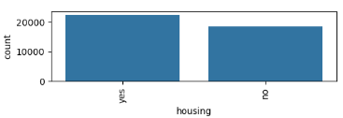
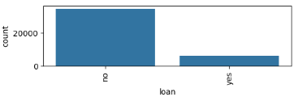
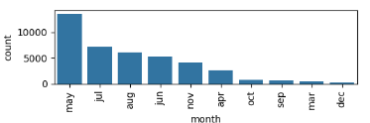
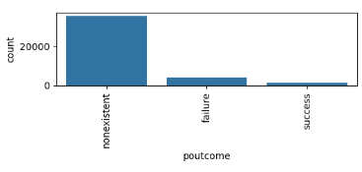
EDA (Univariate Analysis of Categorical Features)
There are more people with a house loan compared to those without a personal loan.
We have more data from May and less from December.
Most of the poutcome are failures.
There are significantly more cases of "no" compared to "yes" in the default feature, so will drop this.
The conclusions from the bar graphs are shown on the left.

Slide 13
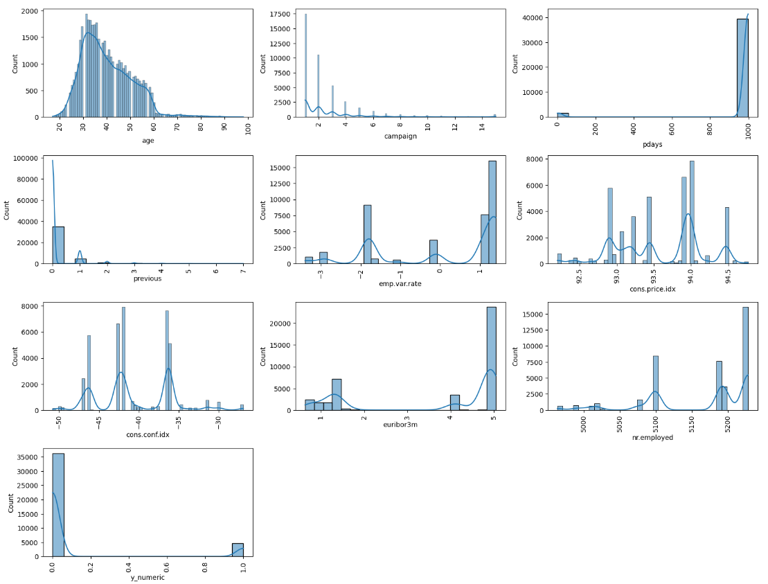
EDA (Univariate Analysis of Numerical Features)
There are 9 numerical features in the dataset, excluding the target variable (y_numeric)
The histograms show how the data is distributed.
Based on these histograms, I have addressed issues like outliers and skewness.
Most of the people contacted are between the ages of 20 and 60.

Slide 14
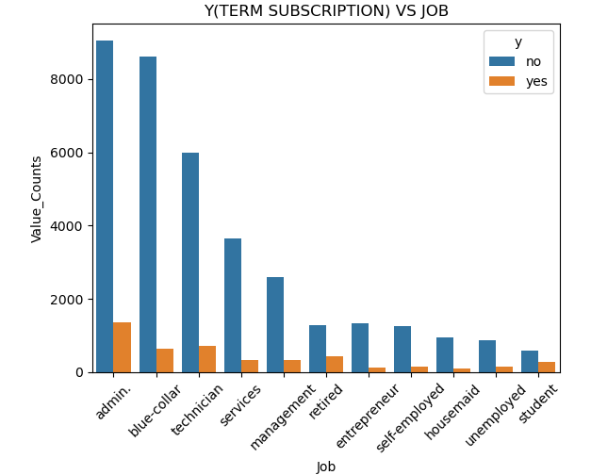
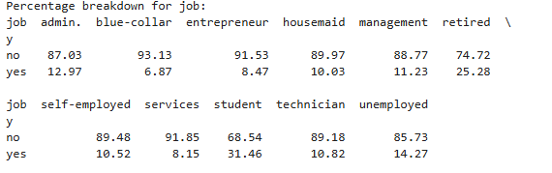
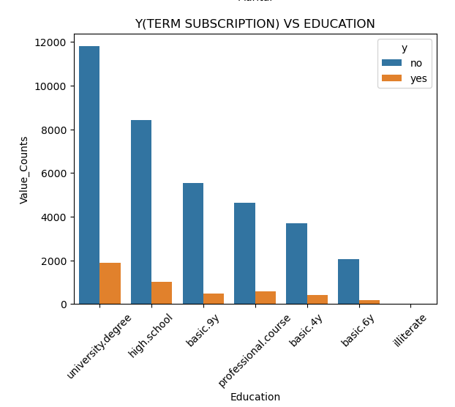
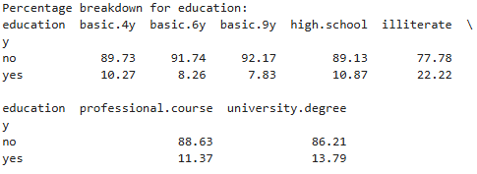
EDA (Bi-variate Analysis of Categorical Features w.r.t term deposit)
Even though many people work in administrative jobs, retirees are more interested in term deposits.
Most clients are literate, but those with less education (like illiterates) actually sign up for term deposits more, followed by those with university degrees.

Slide 15
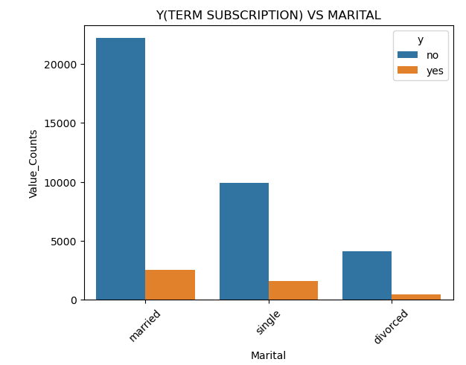

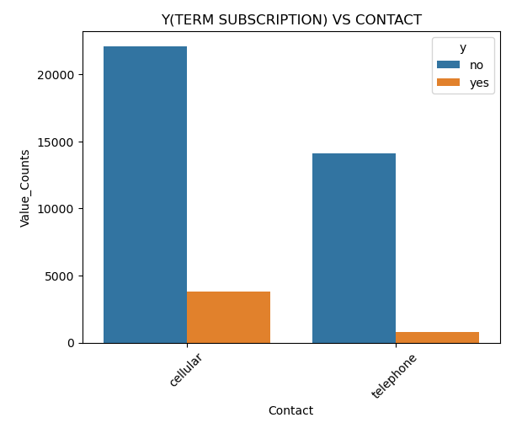

EDA (Bi-variate Analysis of Categorical Features w.r.t term deposit)
Single people are more likely to sign up for term deposits compared to those who are married.
Clients contacted by cell phone have a better chance of subscribing to term deposits compared to those contacted by telephone.

Slide 16
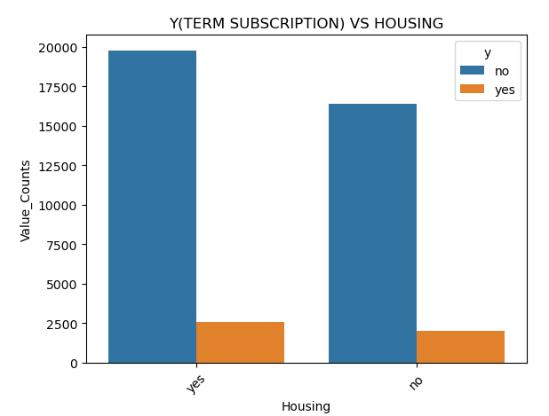

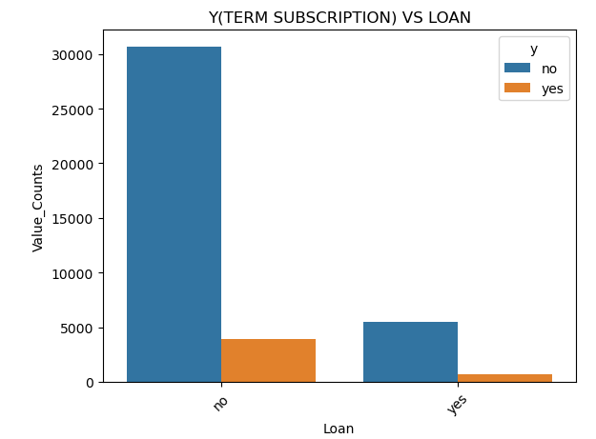

EDA (Bi-variate Analysis of Categorical Features w.r.t term deposit)
People with personal loans are less likely to sign up for term deposits compared to those with house loans. Overall, having a loan doesn’t seem to affect the likelihood of subscribing to term deposits much.

Slide 17
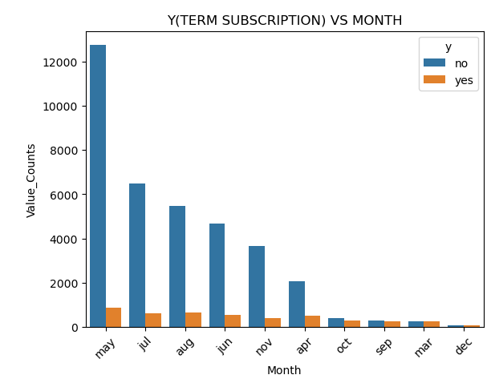
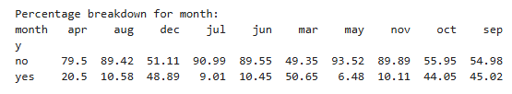
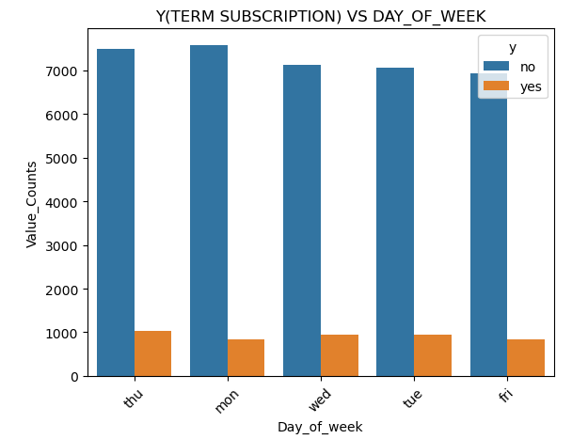

EDA (Bi-variate Analysis of Categorical Features w.r.t term deposit)
There is more interest in term deposits in December, March, October, and September. Subscriptions happen most often on Thursdays and Tuesdays.

Slide 18
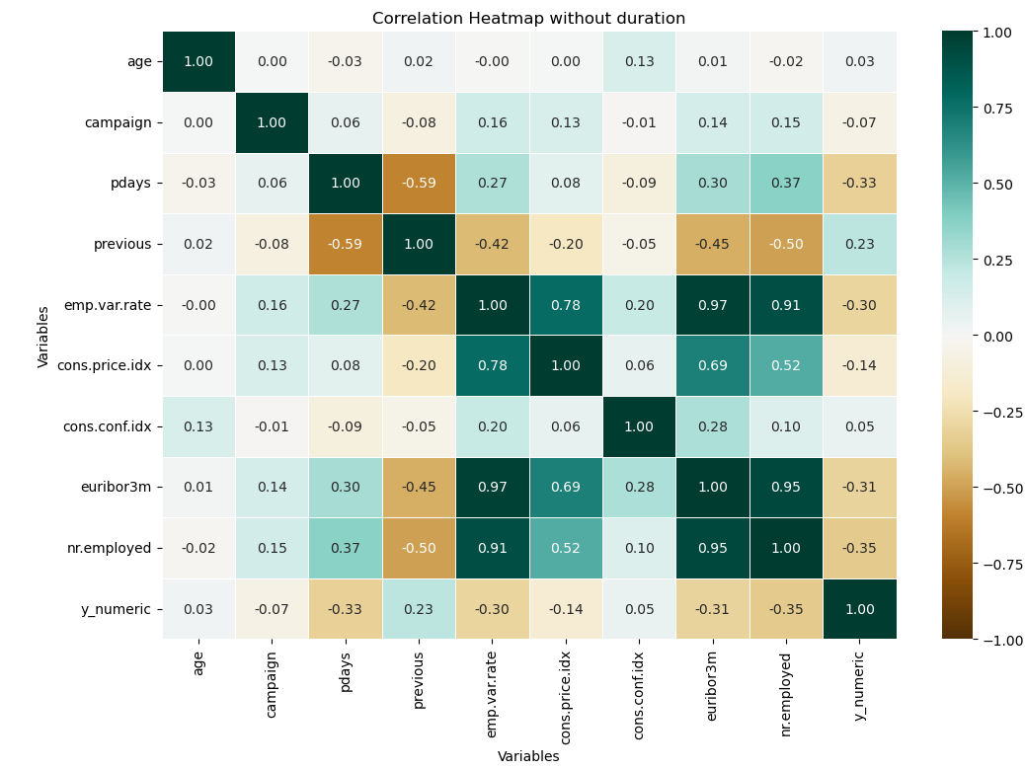
EDA (Bi-variate Analysis of Numerical Features w.r.t term deposit without duration feature)
A correlation heatmap shows how closely different things in a group are connected. It helps to quickly spot patterns and decide which variables might be important for further Analysis.
From the heatmap we can say that no two variables have strong positive or negative relationship.
Note:- correlation does not imply causation means that just because two things correlate does not necessarily mean that one causes the other

Slide 19
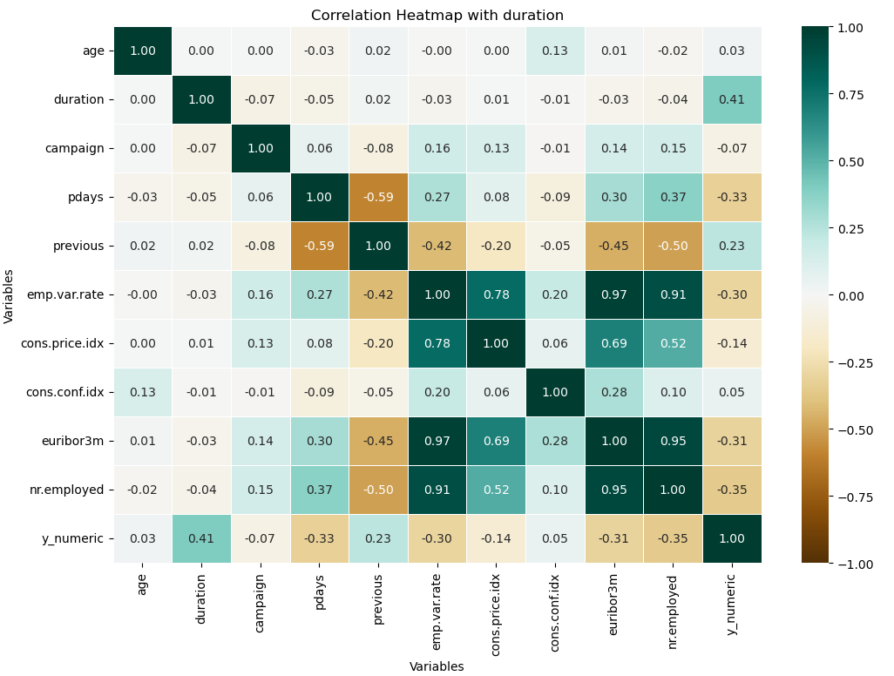
EDA (Bi-variate Analysis of Numerical Features w.r.t term deposit with duration feature)
We avoided using the duration feature in the initial analysis because it has a strong influence on whether a term deposit is subscribed. However, the duration is only known after a call is made, which makes it less practical for building a predictive model. Since our goal is to predict outcomes before a call, we will only use the duration feature to compare model performance, not for the actual predictions.
Note:- correlation does not imply causation means that just because two things correlate does not necessarily mean that one causes the other

Slide 20
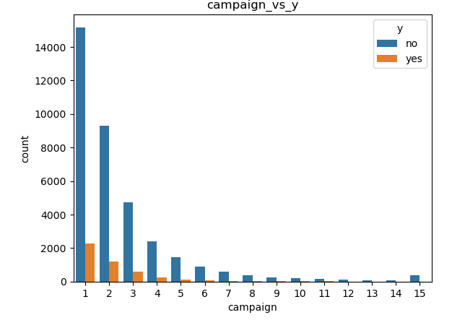
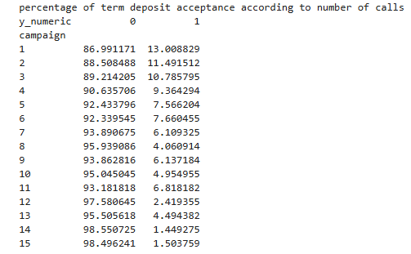
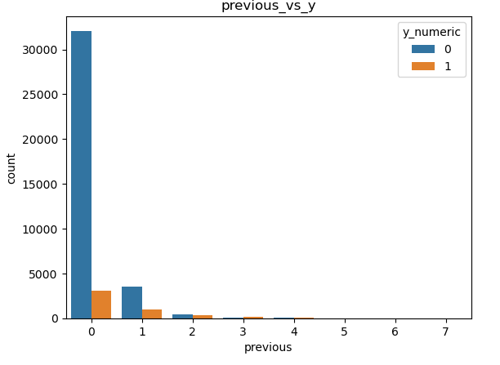
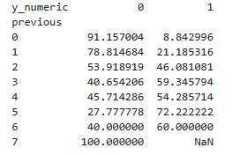
EDA (Bi-variate Analysis of Categorical Features w.r.t term deposit)
can say that more contacts do not necessarily lead to more term subscriptions.

Slide 21
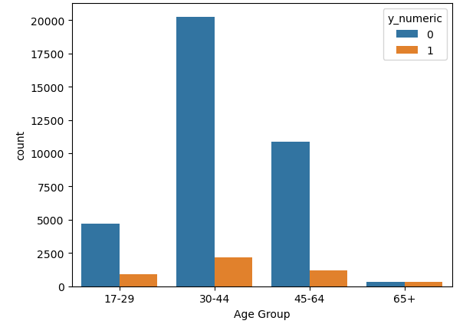
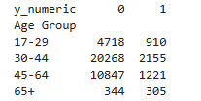
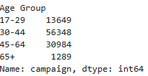
EDA (Bi-variate Analysis of Categorical Features w.r.t term deposit)
We can say that people aged between 30 and 64 have fewer term deposits compared to other age groups.
Most of the calls were made to individuals aged between 30 and 64.
Total Number of calls made according to age brackets.

Slide 22
EDA Summary
Key Findings:
None of the variables are strongly connected to the target (whether someone subscribed).
Retirees and single people are more likely to subscribe to term deposits.
People tend to subscribe more when contacted by phone.
The highest number of subscriptions happened in December, March, October, and September, mostly on Thursdays and Tuesdays.
Also, making more calls doesn’t guarantee more subscriptions. But focusing on these patterns could help increase term deposits.

Slide 23
Recommended Models
Since our problem is a binary classification (yes or no) with imbalanced data, I have chosen the following models:
Logistic Regression: A simple, easy-to-understand model. However, it might not perform well with complex relationships, so we will use this as a baseline.
Decision Tree: Handles both numeric and categorical values and helps identify important features, but it may overfit the data.
Random Forest (Ensemble Model): Solves the overfitting issue in decision trees and manages imbalanced data by adjusting class weights.
Gradient Boosting Machines (GBM) or XGBoost: Like Random Forest but more accurate. These models handle non-linear relationships well and are effective for imbalanced data.
There are other models, but these are better suited for handling imbalanced data. As mentioned earlier, I will use resampling techniques to balance the data. We will evaluate model performance using metrics like F1 score, precision, recall, etc. Based on these, we will fine-tune the models and decide which one to use for the final predictions. We will also compare the performance of models with and without using the duration feature.

Slide 24
Thank You

